Slide 1
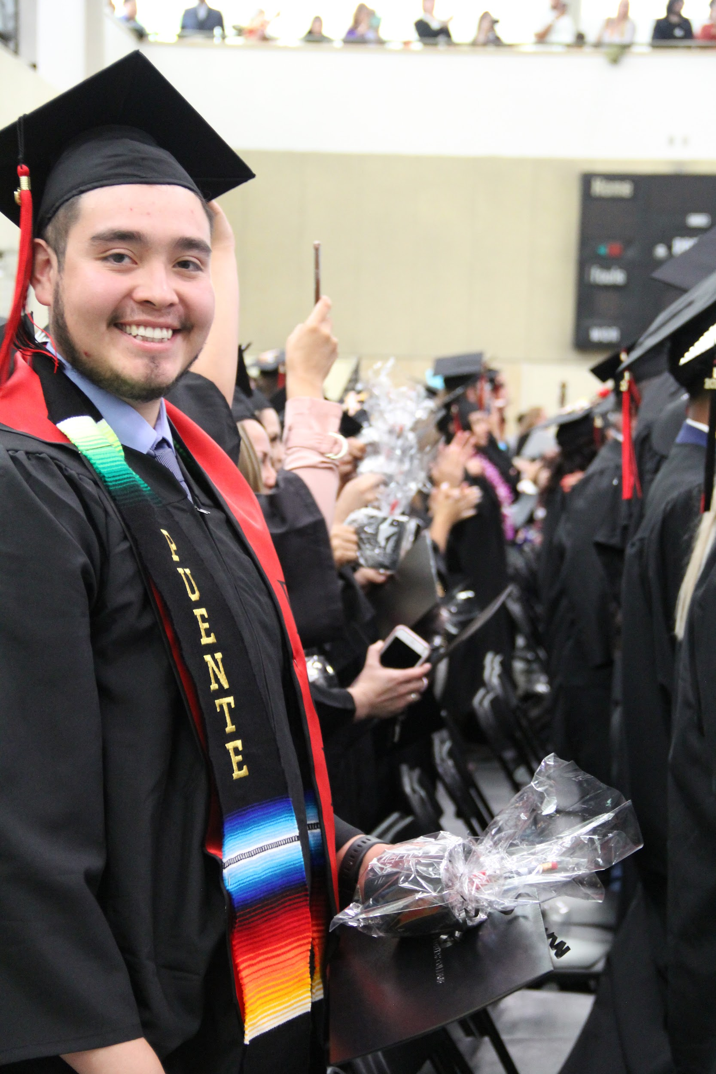
East Bay College Agile Network (CAN) Goal
Produce an equity-centered network design between CSUEB, CLPCCD, Chabot College, and Las Positas College focused on greater transfer agility, supporting students to find their best path forward to experience higher education inclusion and reach higher education completion.
Notes:
Kris – I will be your MC and facilitator. SPR Associates is the TA and Eval firm supporting EBCAN

Slide 2
Purpose and Goals
Introductions and overview of EBCAN
Celebrate EBCAN’s 2021-22 accomplishments
Hear EBCAN’s direction for 2022-23
Synergy and collaboration found across teams
Alignment opportunities shared for related initiatives
Opportunities shared for resources and support
Notes:
Kris

Slide 3
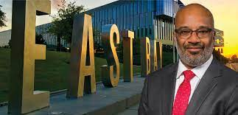
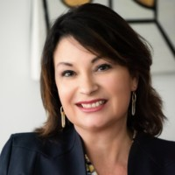
Welcome
CSUEB Provost Walt Jacobs
CLPCCD
Vice Chancellor
Theresa Fleischer Rowland
Notes:
2 minutes
Theresa and Walt welcome

Slide 4
Agenda
1:00 – 1:10 pm Welcome and Introductions
1:10 – 1:20 Steering Committee: EBCAN History, Context, and Importance
1:20 – 1:55 Team Presentations: Accomplishments and Looking ahead
Technology and Data
Pathways
Student Supports
Communications
1:55 -2:05 Steering committee: Reflections, Commitments, Vision forward
2:05 – 2:50 Points of connection: small group discussion and discovery
2:50 - 3:00 Closing and next steps
Notes:
Kris
This is a big month for transfer!
Transfer Week at Chabot is Oct 10-14 culminating in a big tour of CSUEB. You'll hear more about this from our student support team in a bit. Meanwhile—see some of the activities coming up in the chat.
This is the Transfer Day/Week webpage: https://www.chabotcollege.edu/counseling/transfer-center/transfer-day.php
And on it, is a link to the pdf of the schedule: https://www.chabotcollege.edu/counseling/transfer-center/docs/td22%20schedule.pdf
http://www.laspositascollege.edu/transfercenter/events.php

Slide 5
Introductions
Notes:
Now we'd like to hear from every person on the call—please introduce yourself in the chat with your name, institution and role. Please turn on your camera for the next few minutes for our introduction session. If you know how to rename –put your institution with your name.
If you've got any events related to student transfer—I invite you to get your links in the chat too at any point so we all walk away with critical information to share with all the students we know at our EBCAN colleges and all the people we know that interact with our students who intend to transfer.
Kris to welcome all. Shout out to EBCAN steering committee members + President Sandeen! Shout out to each team (tech, pathways, student supports, data, communications)—waves to the group. We're going to talk about some sister-initiatives today too—all those involved in the HSI stem grant? all those involved with K-16 Collaborative?
Now we'll hear from two of our steering committee members to give those of you who are newer to EBCAN a sense of history, context, structure and why this work is so important.

Slide 6
Vision
Develop the Agile Network that is scalable, equity-centered, and improves students' success across all demographics, leverages learning and supports on each campus, and fosters an expandable regional partnership.
Integrated Pathways: further articulate shared pathways among the three campuses to reduce barriers and support students’ goal orientation and focus, thereby increasing the number and diversity of students reaching higher ed goals.
Student Supports: Coordinated workflows to ensure transfer processes are seamless and student experience are positive and inclusive on each campus.
Technology tools: get transfer information into the hands of students, faculty, and advisors
Notes:
Theresa

Slide 7
Team Structure and Charges
We convened four intersegmental project teams with the following charges:
Technology/Data Team design and implementation of data analytics and data sharing among the campuses.
Pathways Team map catalog connections and equity-focused alignment, articulating degree pathways, and developing flexible roadmaps (guided pathways) among the campuses.
Systems and Support Team design a shared seamless transfer system including cross enrollment, student supports, and movement between campuses and is intentional about effective equity practices.
Communication/Public Relations Team developing a messaging to educate students and student support services personnel of the pathway and degree options available through this collaboration.
Notes:
Theresa

Slide 8
Transfer Enrollment Data
 | Chabot Applicants | LPC Applicants | Chabot Admits | LPC Admits | Chabot Enrolled | LPC Enrolled
Fall 2020 | 754 | 479 | 474 | 436 | 383 | 164
Spring 2021 | 218 | 116 | 155 | 94 | 123 | 60
Fall 2021 | 673 | 376 | 392 | 343 | 319 | 129
Spring 2022 | 218 | 137 | 142 | 120 | 111 | 54
Fall 2022 | 560 | 343 | 515 | 314 | 251 | 124
Notes:
Provost Jacobs

Slide 9
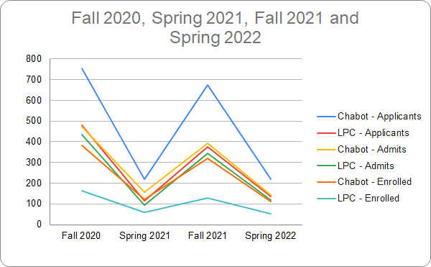
Transfer Enrollment Data
Notes:
Provost Jacobs
Kris to transition us to the next slide

Slide 10
EBCAN Teams Presentations
Notes:
Kris—now we'll move to presentations
First Data team, then pathways, then Student Supports, then Communications.
We heard in our EBCAN research that student data analytics are in many different places, living in silos. Messaging to transfer students comes at them from many different places—not necessarily in a coordinated way. Info about which courses count for transfer needed to be confirmed earlier for students to optimize how they sign-up for courses. We'll first hear from data team and learn about exciting new tools and data sharing between

Slide 11
Technology/Data Team’s Goal
Design and implementation of data analytics and data sharing among the campuses.
Technology Team - Accomplishments
Data Sharing Agreement
Early proof-of-concept, entry level integration
CSUEB-created ingest form
CLPCCD proof-of-concept portal
Completed ingress process and form for Pioneer Bound CCLP students developed to feed their data into CSUEB Peoplesoft.
Pioneer Bound CCLP students can log into the CSUEB portal for access to: degree progression and mapping and transfer progress into the program
Initial testing for this process has been successfully completed with current CCLP students
Notes:
Bruce + team

Slide 12
Data Team – Looking forward 2022-23
Launch Ellucian Experience with Compass integration
Single sign on
Training for faculty and staff; student focus group/user experience
Meetings: Cross-institutional developers, EBCAN teams
Launch CRM Advise
Paths from Degree Works and Curricunet to CSU Mapper
Continue to develop critical relationships that foster collaboration between institutions and data staff.
Notes:
Bruce + team

Slide 13
Pathways Team – Goals
Pathways Team map catalog connections and equity-focused alignment, articulating degree pathways, and developing flexible roadmaps (guided pathways) among the campuses.
Notes:
Kris – now we'll hear from our pathways team which is ramping up and has the important work of aligning degree pathways.
Clarissa

Slide 14
Pathways Team – Accomplishments
Mapping Software selected at all Institutions
Chabot College-Meta
Las Positas and CSU EastBay- Program Mapper
11 Transfer Pathways agreed upon
Transfer pathways mapped and integrated into software at Las Positas and Cal State University East Bay
Transfer pathways are mapped, software selected with implementation timeline detailed for Chabot College
Faculty supporting each of the pathways
Notes:
Jill Carbone

Slide 15
Pathways Team – Looking Forward 2022-2023
· Host workshop(s) for the top Pathways faculty (likely with CSU President’s Office)
· Initiate Chabot College and Las Positas College faculty contact for selected degree pathways
· Maps for Las Positas and Chabot be added to program mapper for CSUEB.
· Publish full 4-year program maps for top degrees to students at LPC.
· Establish process for annual updates to mapper.
· Determine linkage for Chabot and CSU.
· Tech Team engagement.
Notes:
Alice Hale

Slide 16
Student Support Team - Goals
Student Supports: Coordinated Workflows to ensure transfer processes are seamless and predictive analytics can support students on each campus. Support Students in:
Exploring their transfer options
Making meaningful connections and belonging
Making progress toward transfer
Applying (admissions & financial Aid) to CSUEB
Deciding and Transitioning to the CSUEB
The SS Team has meet biweekly from September 2021-September 2022. All meetings have had full participation from all EBCAN college partner campuses.
Notes:
Frances
Introduce FF:
--Has been the lead facilitator and backbone for the group.
--Has kept a detailed spreadsheet with all of the work with the plans, the accomplishments.
--She has driven much of the inquiry for the evaluation, seeking to get more student voice on how things are working/not working; she has redesigned and stepped up work.
--Then we'll hear accomplishments from Terrance Thompson at LPC who pushed the group to get students on the ground last year and when he documented the tour it ended up being included in convocation for the whole district and prompted more attention to EOPS partnership.
--Then we'll hear from communications who have been gearing up capacity to take a bigger role in the coming year.
Ask her:

Slide 17
Student Support Team – Accomplishments (1)
Exploring
Developed transfer resource webpage with CSUEB-focused events calendar: Pioneer Bound
Created a START to FINISH Infographic for transfer
Transfer Tuesdays was born out of EBCAN
Evening session added for homebound students featuring CSUEB financial aid and PACE
Chabot TC Mini-Transfer Days featuring CSU East Bay Transfer Student Ambassadors
Belonging
LPC EOP&S students attend CSUEB for campus visit/tour. CSUEB’s first post-pandemic tour.
Created a directory of affinity groups and contacts.
LPC TC held affinity group and transfer cohort programs during Transfer Week.
Chabot TC presented transfer options workshop to psychology majors in Society, Culture & Ideas Pathway.
Notes:
Terrance

Slide 18
Communications Team – Accomplishments
Supported fast-tracking of EBCAN data sharing agreement.
Kicked-off collecting university and community college transfer-related materials, assets and communication needed for audit review.
Determined that surveys would be conducted. Selected a market research firm to develop survey,
Conduct interviews and perform analysis to determine most engaging communications channels.
Identified “branding” colors and identity
EBCAN Newsletter published featuring transfer student voices and EBCAN Teams’ activities.
Website created.

Slide 19
Communications Team – Looking Forward 2022-2023
Increase intentional internal messaging (website, newsletters, external synergistic programs)​
Further establish and promote Communication Teams' role
Support and engage other EBCAN Teams (Student Suppor​ts, Pathways, Technology)
Regularize meeting schedule
Increase awareness of EBCAN and other synergistic efforts
Support surveys and research
​

Slide 20
Student Support Team – Accomplishments (2)
Progress toward Transfer
Chabot TC piloted CSU Application Readiness workshop prior to application submission period
SS Team participated in cross-registration problem solving, interviews, developed recommended courses.
Applying
Chabot TC and CSUEB engaged in discussions on reducing costs related to transcript requests, how to address application fee waiver challenges.
Deciding and Transitioning
CSUEB Hosted Admitted Transfer Student Workshops with CLP
CSUEB shared roster of admitted students with CLP
CSUEB connected students with appropriate Major or ADT/BABS Advisor
Notes:
Terrance

Slide 21
Student Support Team – Looking forward 2022-23 (1)
Exploring
SST make connection to the pathway mapping group to see how to include student supports pieces INSIDE the maps
Explore what activities are linked to majors
CSUEB student ambassadors more engaged with LPC-CC prospective students via social media, tours
Transfer Fridays at CSUEB and Transfer Day, virtual info nights
Belonging
Continued Puente/Ganas event(s) and/or tours and new connections for Umoja/Sankofa
SST Explore adding pathway affinity group connection resource to “4-year map” advisory notes
Leverage existing affinity group events to INSERT transfer information.
Basic needs connections across this partnership
Notes:
Katie and Jamee

Slide 22
Student Support Team – Looking forward 2022-23 (2)
Progress on Transfer
Integrate Chabot & CSUEB FinAid Office sponsored FAFSA/CADAA workshops into Pioneer Bound resource webpage and events.
Partner w/LPC Fin Aid for targeted FAFSA workshops & scholarships.
Learn more about the reverse transfer story.
Applying
Hold CSUEB University Financial Aid Workshop during Chabot Transfer Week.
Partner with CSUEB to offer in-person CSU Application and Application Support at Chabot TC.
Resources
Increase knowledge of what students experience with financial aid through student focus groups.
Adding tacos to Transfer Tuesday! Plus resources available at the next level with CSU HOPE tables at Transfer Tuesday.
Notes:
Jamee and Katie

Slide 23
Steering Committee Reflections, Commitments, Vision
CSUEB Provost Walt Jacobs
LPC President Dyrell Foster
CC Vice President Matt Kritscher

Slide 24
Small Groups Poll

Slide 25
Small Group Topic Choices – Poll, Sign up
Data Tools – Student E-navigation
Pathways – Four Year Program Maps
Student Supports and Soft Landings

Slide 26
Questions for All Small Groups
Seeing the work that will commence going forward for 2022-23, what do you see on the slide or hear in the presentation that energizes you about the coming year about this work?
From a student’s perspective, what on this list do you see as a high priority and why?
What other initiatives or campus work overlap?
For this work to be even more successful, is there anyone else besides the current team members who would need to be engaged to achieve the work? And/or any additional resources needed?
Notes:
Kris

Slide 27
In closing
Each participant (in chat)
Share a wish you have for Chabot College and Las Positas College transfer students as they pursue their academic dreams and goals at CSU East Bay.
Notes:
Kris – in chat or out loud

Slide 28
EBCAN Resources
CLPCCD EBCAN Webpage:
http://districtazure.clpccd.org/education/eb-can.php
Notes:
Kris

Slide 29
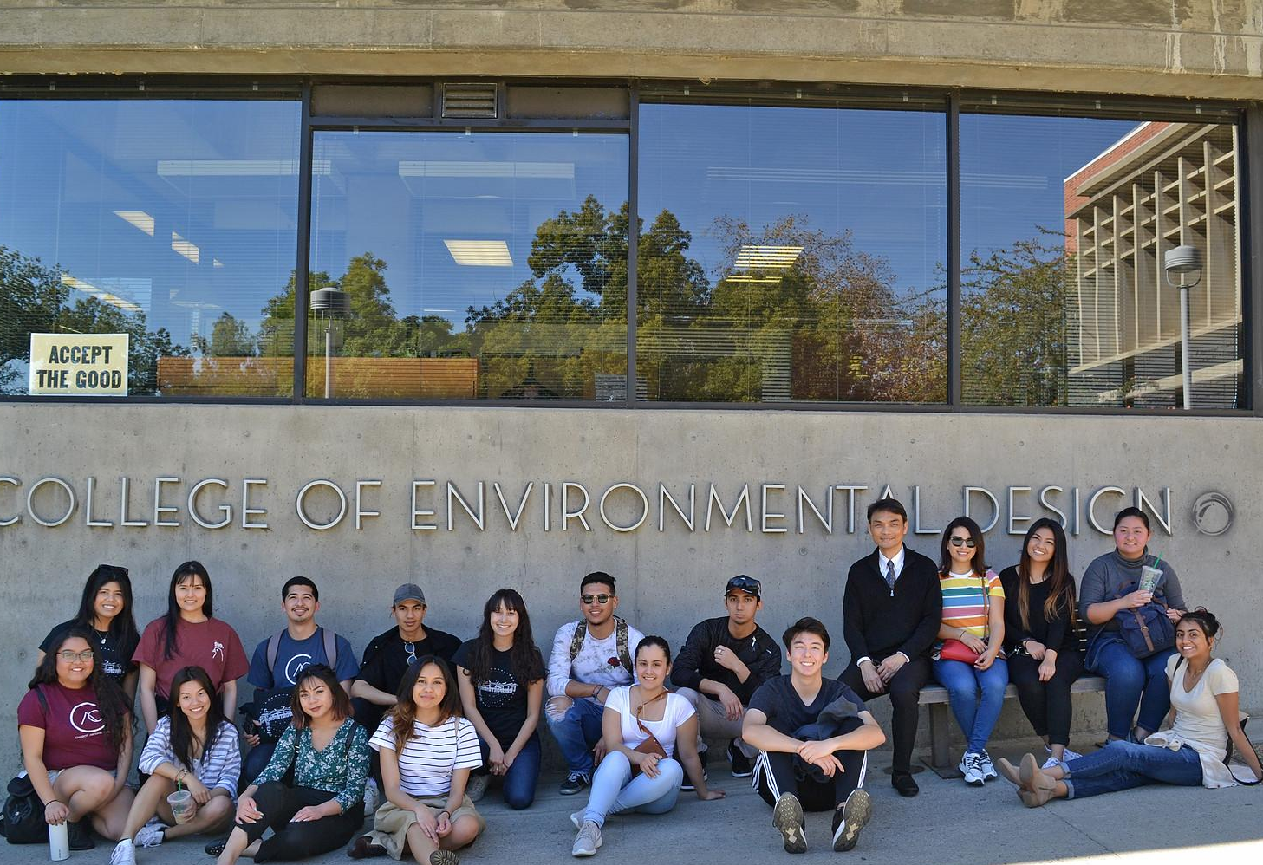
Follow up Questions:
Steering Committee
CSUEB Provost Walt Jacobs
LPC President Dyrell Foster
CC Vice President Matt Kritscher
CLPCCD Vice Chancellor Theresa Fleischer Rowland
Team Leads
Student Supports, Frances Fon
Data and Technology, Bruce Griffin
Pathways, TBD
Communications, TBD
Support
Ilona McGriff, Consultant to EBCAN
Kris Palmer, TA/Evaluation, SPR Associates
THANK YOU!
Notes:
Kris

Slide 30
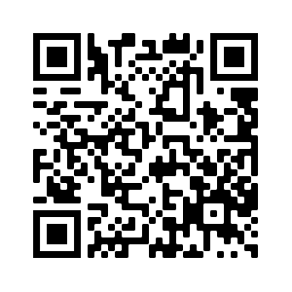
Las Positas College
Transfer Week
October, 2022
10/3/22 – Transfer Basics Workshop @ 11am – 12pm – Rm # 1604
10/4/22 - UC/CSU Application Open Lab @ 11am – 12pm – Rm # 1604
10/5/22 – Transferring out of State ASU Workshop @ 11am – 12pm (Virtual)
10/6/22 – CCC to HBCU Workshop - @ 1pm – 2pm (Virtual)
10/6/22 – UC Personal Statement Workshop @ 11am – 12pm – Rm # 1604
Click QR Code

