Slide 1
Alternative Academic Calendar Project Key Choices in Compressed Calendar Design
JOHN MULLEN, consultant

Slide 2
Alternative Academic Calendar Project REVIEW OF THE BASIC REQUIREMENTS
Although there are many choices to be made when designing a compressed academic calendar, important basic requirements specified in the Education Code and Title 5 must apply.
Let’s review the fundamentals that are required of all academic calendars.

Slide 3
Alternative Academic Calendar Project MINIMUM REQUIREMENTS
Required Days and Weeks of Instruction
The academic calendar must include at least 175 days of instruction (including final examination days).
The primary terms of the calendar must include at least 32 weeks of instruction. Each of the required weeks must have at least three days of instruction.
CLPCCD BP and AP 4010 Academic Calendar

Slide 4
Alternative Academic Calendar Project REQUIRED DAYS OF INSTRUCTION
175 Days in 32 Weeks ?
Since 32 x 5 = 160, in order to allow districts to meet the 175-day requirement within 32 weeks, the State approved a change in the minimum requirement for a “day” of instruction to allow Saturdays and Sundays to be counted if they include at least three hours of instruction.
Colleges must offer some weekend classes in order to operate with a compressed calendar.

Slide 5
Alternative Academic Calendar Project MANDATED HOLIDAYS
State-mandated Holidays
The firm rule concerning mandated holidays applies to all academic calendars, traditional and compressed.
No hours of instruction can be reported for apportionment funding for classes held on the ten mandated holidays.
None of those holidays can be counted toward the 175-day requirement.
CLPCCD AP 4010 Academic Calendar

Slide 6
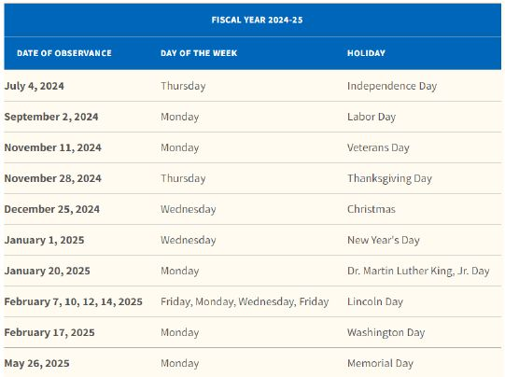
Alternative Academic Calendar Project MANDATED HOLIDAYS

Slide 7
Alternative Academic Calendar Project FUNDAMENTAL COMMITMENT
Integrity of the Credit Hour
In converting to a compressed calendar, the district must commit to retain the integrity of the credit hour.
In every case, the student must continue to receive the specified number of hours of instruction previously provided under the traditional 35-week academic calendar.
CLPCCD BP and AP 4020 Program, Curriculum, and Course Development

Slide 8
Alternative Academic Calendar Project COURSE OUTLINES OF RECORD
Course outlines remain basically unchanged:
The total hours of instruction and examination required for each course remain the same.
Changes in the length and scheduling of class meetings are needed to meet the hours requirement of individual courses.

Slide 9
Alternative Academic Calendar Project FTES REGULATIONS
The complex rules for FTES calculation remain in force:
All restrictions such as the minimum session length of 50 minutes apply under a compressed calendar.
Detailed guidelines for scheduling classes are available and should be followed to avoid audit exceptions.

Slide 10
Alternative Academic Calendar Project THE BOTTOM LINE
In summary, most aspects of instruction really don’t change.
Although the timing of instructional activities is very different under a compressed calendar, the basics remain – and must remain – unchanged.
A concept to keep in mind is that we are used to working with a “compressed calendar” in offering summer session classes.

Slide 11
Alternative Academic Calendar Project THE CHOICES
Here are some key choices to be made in designing a compressed calendar:
Fall semester start date
Winter intersession?
Spring semester start date
Spring recess
Number of flex days
Summer intersession(s)

Slide 12
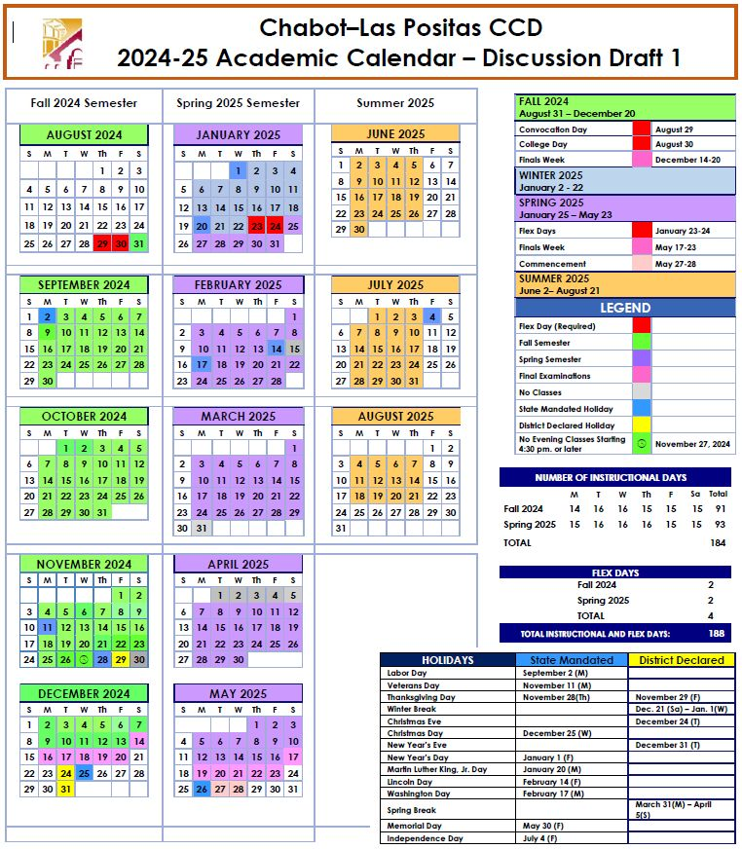
Alternative Academic Calendar Project EXAMPLE DRAFT OF A CLPCCD COMPRESSED ACADEMIC CALENDAR FOR 2024-25

Slide 13
Alternative Academic Calendar Project Key Choices in Compressed Calendar Design
JOHN MULLEN, consultant

